Slide 1
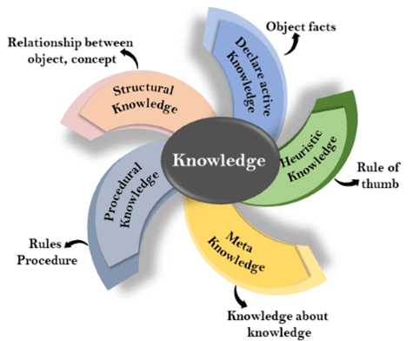
超越学科界限的认知基础 Transdisciplinary Cognitive Foundation
Knowledge Representation Week 6
Image Source: JavaPoint
Ben Koo
October 19, 2020

Slide 2

Abstract Specification
Logic Model
Logic Model
Concrete Implementation
Context: Cognitive activities can be managed in “Namespaces”
Goal: Make Knowledge Computable
Criteria:
Compliant with math insights
Intuitive for human recognition
Utilize Latest Technologies
Output: Render results on mobile devices with uni-expressiveness
Process: Compute in “linked spaces”
Input:
Category Theory nomenclature
Analogies as Universal Constructs
Digital Workflow with IoT/DevOps
A well-defined set of Actions and iterative Branching Strategies
A Roadmap of composable activities
Sequencing and timing conditions
Explicitly state dependencies and resource requirements
Boundary Conditions: Unfamiliarity with Namespace, Category Theory/Computing Science Terminology

Slide 3
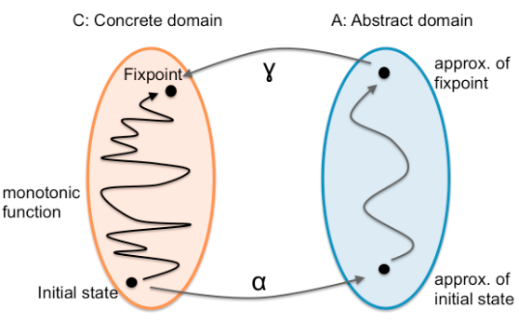
What is Knowledge?
How to convert a problem to a format with known solution,
then, relate it back.

Slide 4
A simple exercise
Can you connect the dots from
A to A’, B to B’, and C to C’ without crossing any lines?
A
C
B
C’
B’
A’

Slide 5
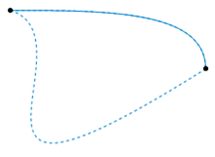
What is a Homotopy?
The two dashed paths shown above are homotopic relative to their endpoints. The animation represents one possible homotopy.
Image and Text Source: https://en.wikipedia.org/wiki/Homotopy

Slide 6
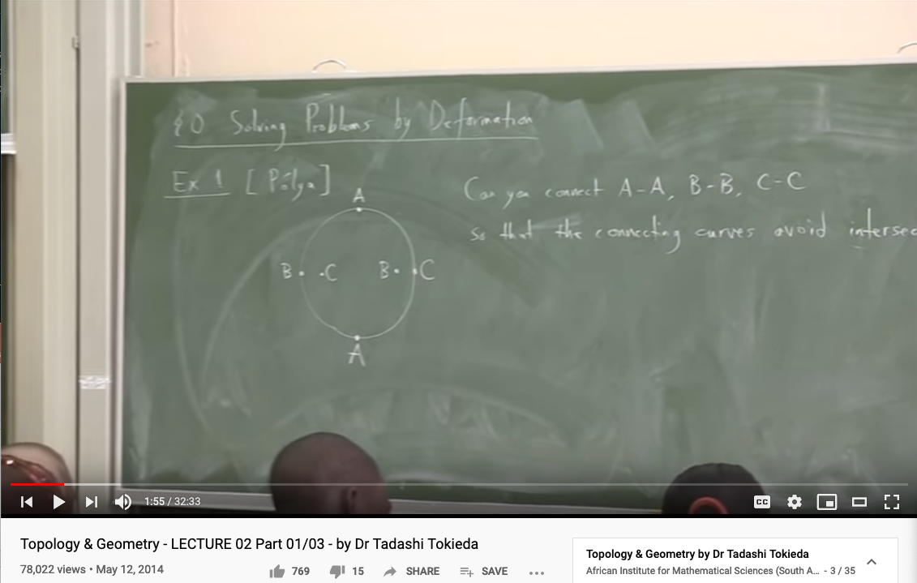
Knowledge Representation in Topology
Youtube Link: https://youtu.be/8YDw4YxT-FM?t=398

Slide 7
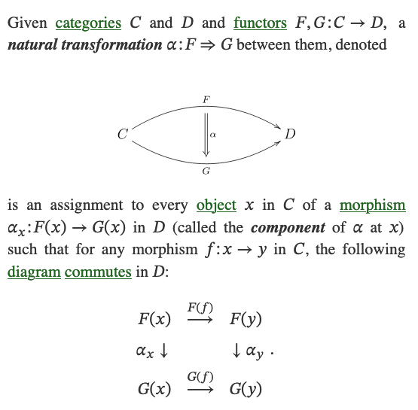
What is a Natural Transformation?
The two dashed paths shown above are homotopic relative to their endpoints. The animation represents one possible homotopy.
Image and Text Source: https://ncatlab.org/nlab/show/natural+transformation

Slide 8
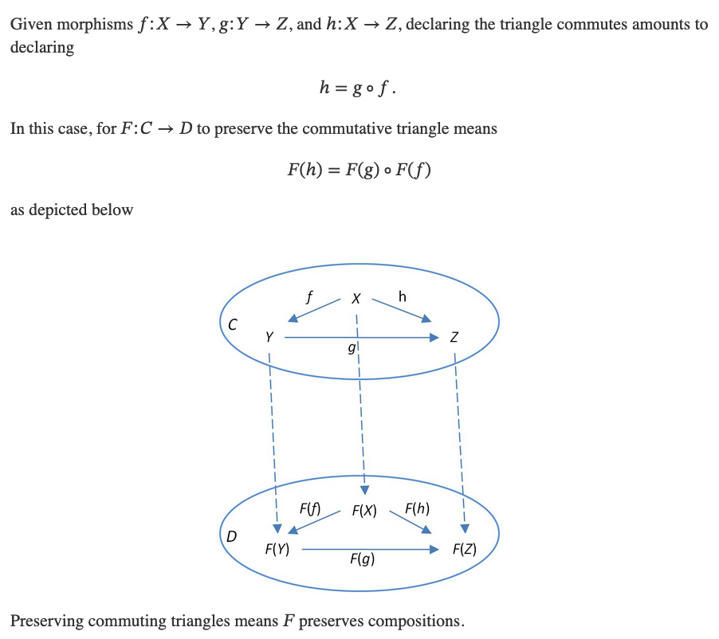
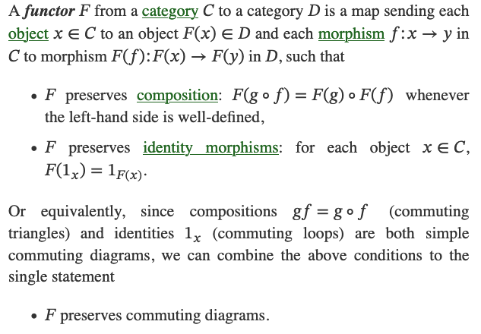
What is a Functor?
Image and Text Source: https://ncatlab.org/nlab/show/functor

Slide 9
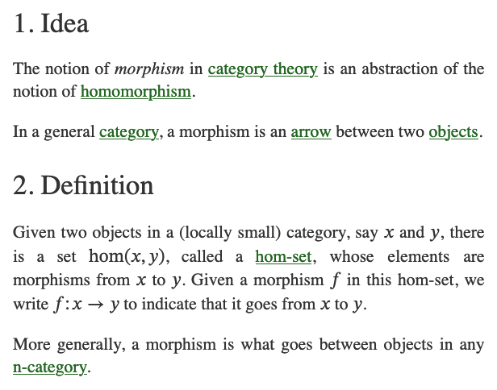
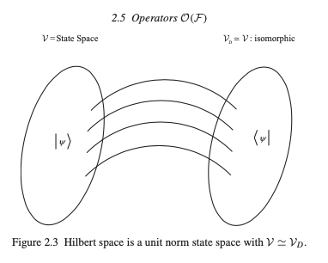
What is a Morphism (Function)?
Image and Text Source: https://ncatlab.org/nlab/show/morphism
Image Source: P.15 of Path Integral and Hamiltonian by Belal Baaquie

Slide 10
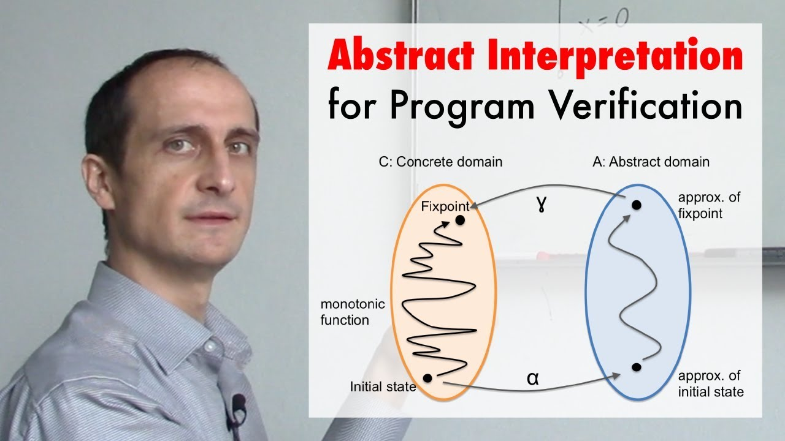
A short introduction video
https://youtu.be/j2m5YMnHvQQ

Slide 11
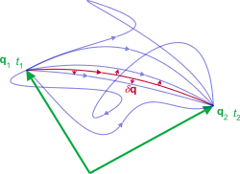
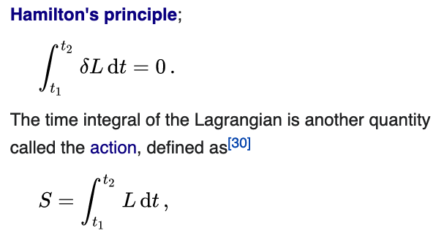
Representation of Action
Namespaces: labeled objects
Computations: transformative actions on the named objects
Action is a mathematical functional which takes the trajectory, also called path or history, of the system as its argument and has a real number as its result. Generally, the action takes different values for different paths.^{[1]} Action has dimensions of [energy]⋅[time] or [momentum]⋅[length], and its SI unit is joule-second. Action is only of interest when the total energy of the system is conserved.^{[2].}
- Wikipedia: Action
As the system evolves, q traces a path through configuration space (only some are shown). The path taken by the system (red) has a stationary action (δS = 0) under small changes in the configuration of the system (δq).^{[1]}
Source of Image and Text: Wikipedia on Hamilton’s Principle
Source of Image and Text: Wikipedia on Lagrangian Mechanics

Slide 12
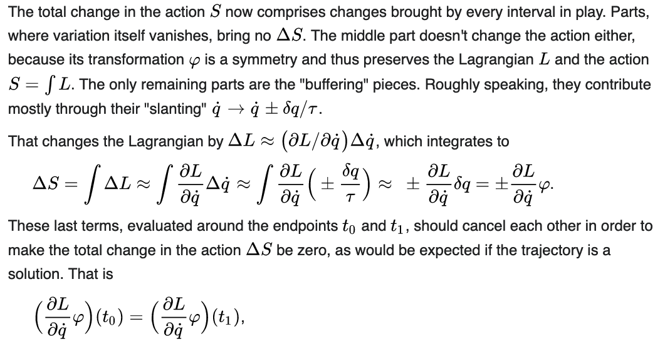
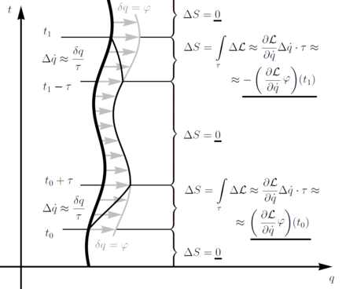
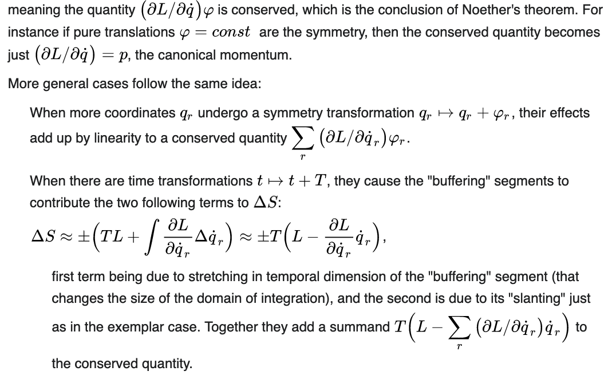
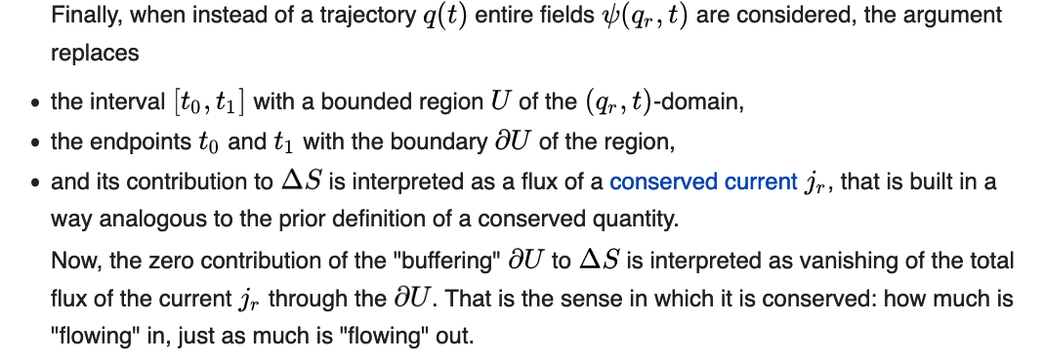
Change in Action S across multiple intervals
Source of Image and Text: Wikipedia on Noether’s Theorem

Slide 13
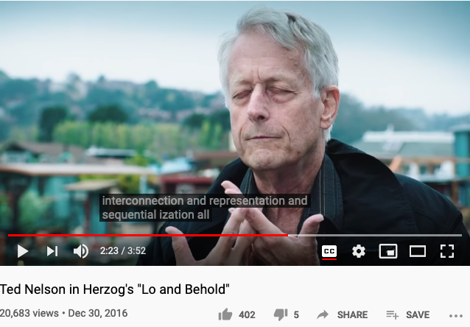
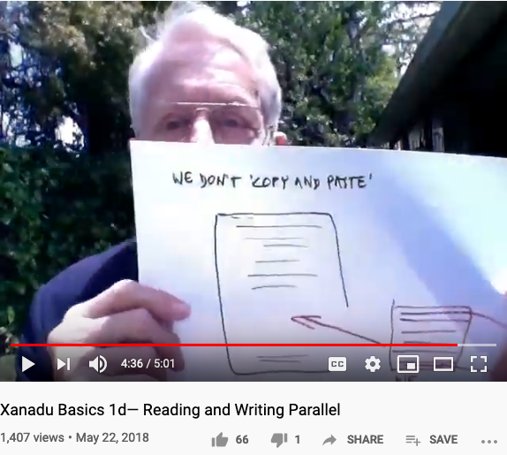
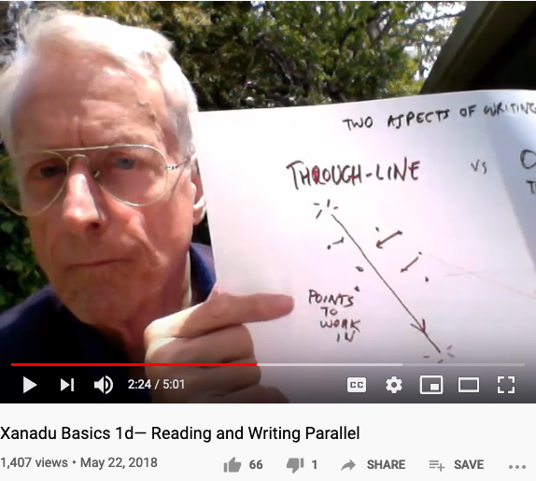
Let’s listen to Ted Nelson’s confession (again)
It was an experience of water and interconnection.
I was with my grandparents in a row boat in Chicago,
so I must have been five years old.
I was trailing my hand in the water and I thought about how the water was moving around my fingers, opening on one side and closing on the other, and that changing system of relationships where everything was kindof similar, kind of the same and the are different that was so difficult to visualize and express and just generalizing that to the entire universe that the world is a system of ever-changing relationships and structures, struck me as a vast truth… expressing that interconnection has been the center of all my thinking and all my computer work has been about expressing and representing and showing interconnection among writings especially. And writing is the process of reducing a tapestry of interconnection into a narrow sequence… they change the meaning of cut-and-paste and pretended it was the same thing… because humanity has no decent writing tools. … I consider that to be a crime against humanity and … this is the problem of interconnection and representation and sequentialization all similar to the issue of water.
- Youtube link: Lo and Behold the movie, section on interviewing Ted Nelson
Ted Nelson : “We don’t copy and paste, we transclude.”

Slide 14
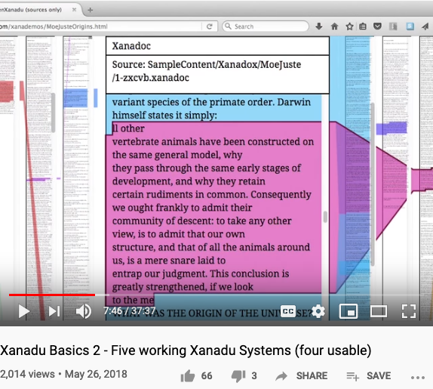
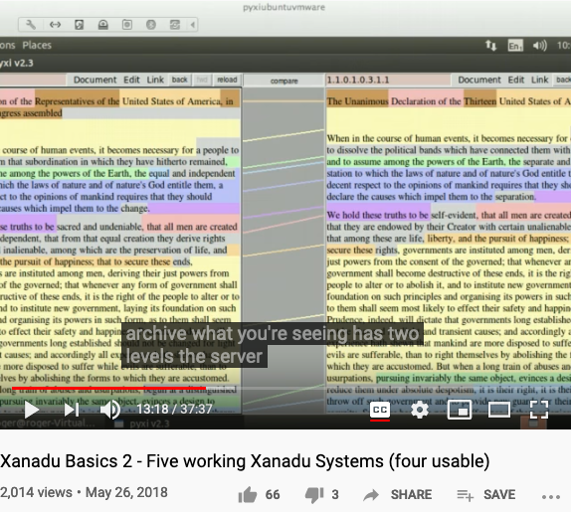

Some implementations of Ted Nelson’s Xanadu
Xanadu Classic is both an Operating System and a Document Management System.

Slide 15
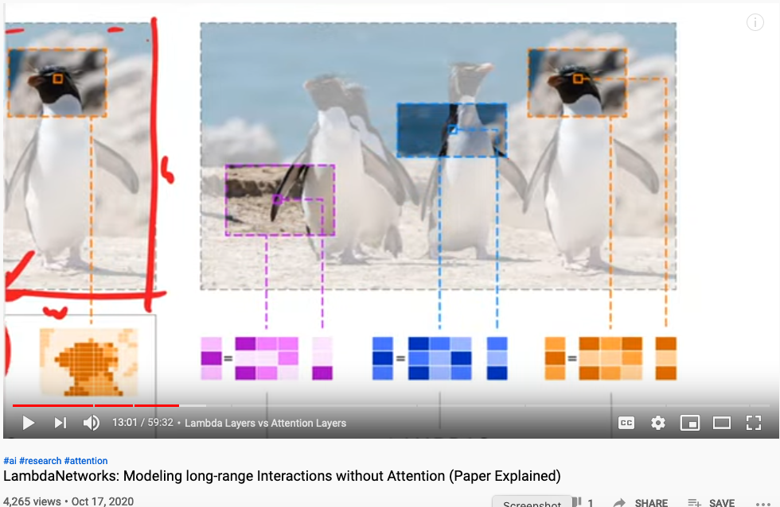
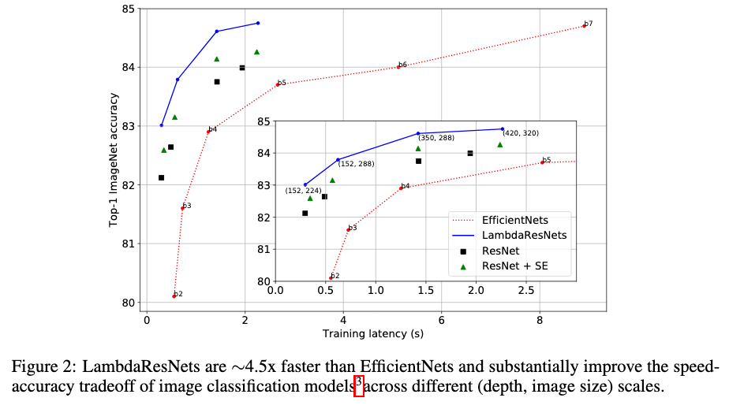
Representing Graphical Information Content
LAMBDANETWORKS: MODELINGLONG-RANGEIN-TERACTIONSWITHOUTATTENTION
Authors anonymous, under double blind review (ICLR 2021) last access: Oct 18, 2020

Slide 16
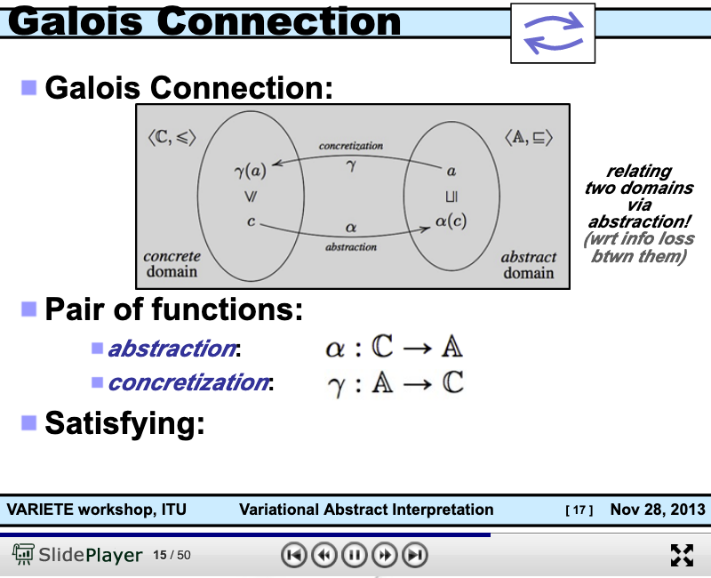
Connecting Abstract and Concrete Domains
https://slideplayer.com/slide/8506871/

Slide 17
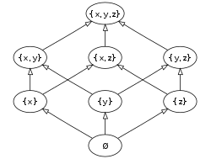
Abstract Interpretation is founded on Partially Ordered Set
The Hasse diagram of the set of all subsets of a three-element set {x, y, z}, ordered by inclusion. Distinct sets on the same horizontal level are incomparable with each other. Some other pairs, such as {x} and {y,z}, are also incomparable. (Image and Text Source: Wikipedia: POS )

Slide 18
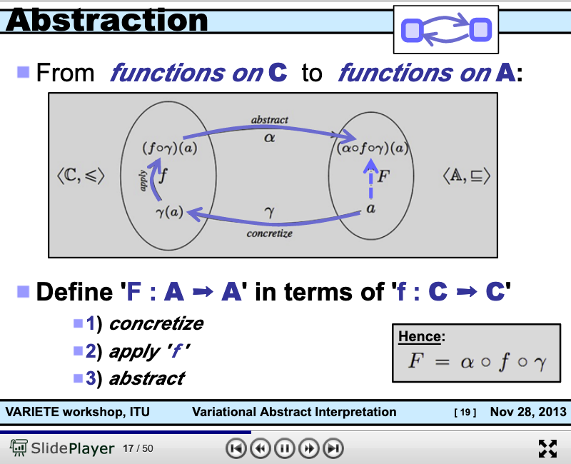
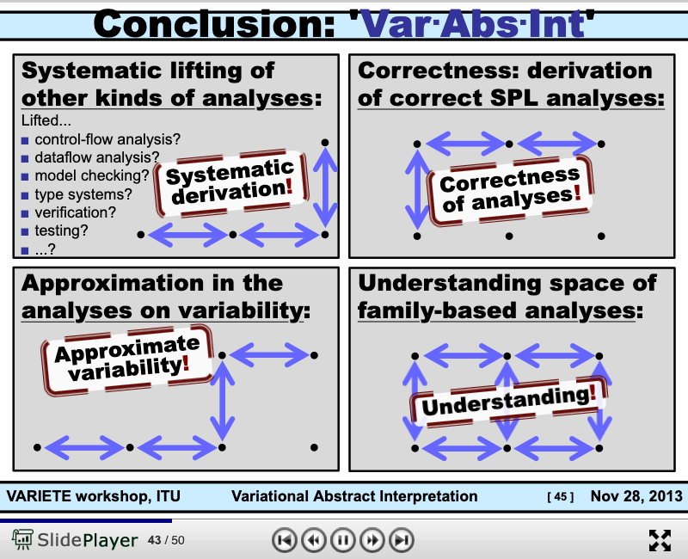
The Basic Working Principle of Composition
https://slideplayer.com/slide/8506871/

Slide 19
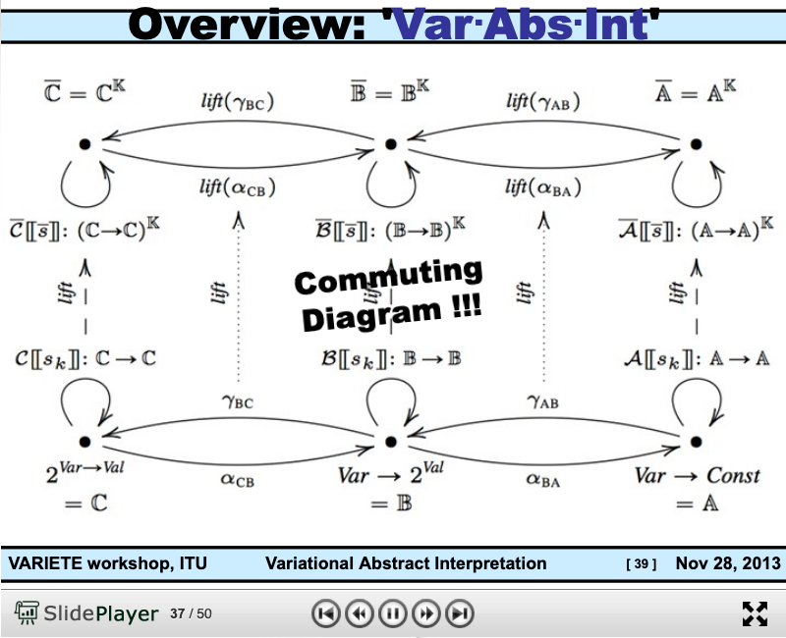
Arrow Chasing Computation
https://slideplayer.com/slide/8506871/

Slide 20
Abstraction
Concretization
Why is abstraction useful?
Allow reuse through universal properties
Avoid resource conflicts
Scale free and domain neutral
Generalizing concrete experience?
Make analogies in localized contexts
Engage sensible metaphors
Define terms and boundaries
A well-defined set of Actions and iterative Branching Strategies
A Roadmap of composable activities
Sequencing and timing conditions
Explicitly state dependencies and resource requirements

Slide 21
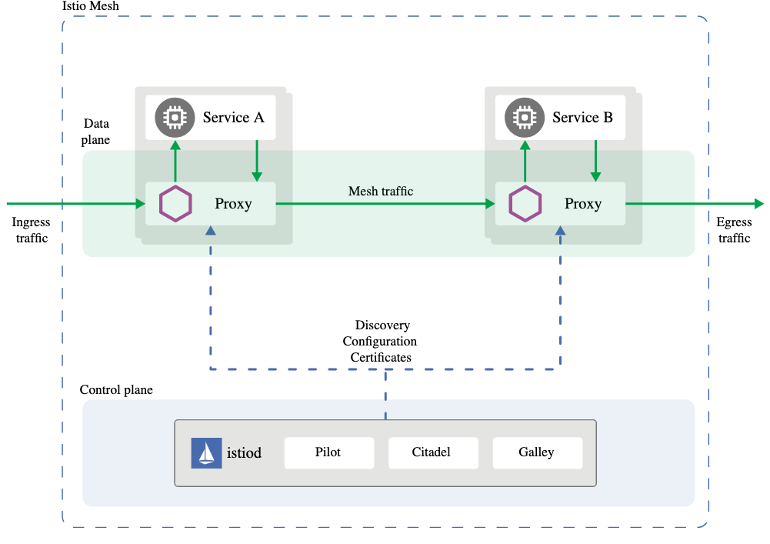
In the world of Internet of Things Checks and Balances
Data Plane
Abstraction
Concretization
Control Plane

Slide 22
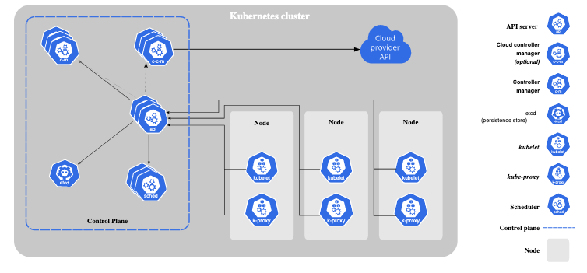
A New Kind of Operating Systems with built-in Governance
Data Plane

Slide 23
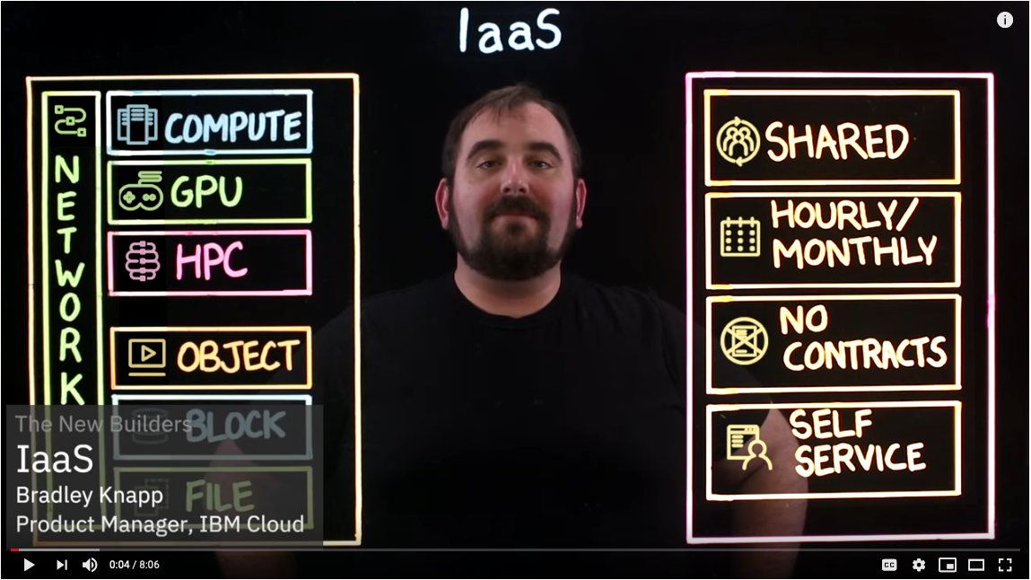
IaaS: Infrastructure as a Service

Slide 24
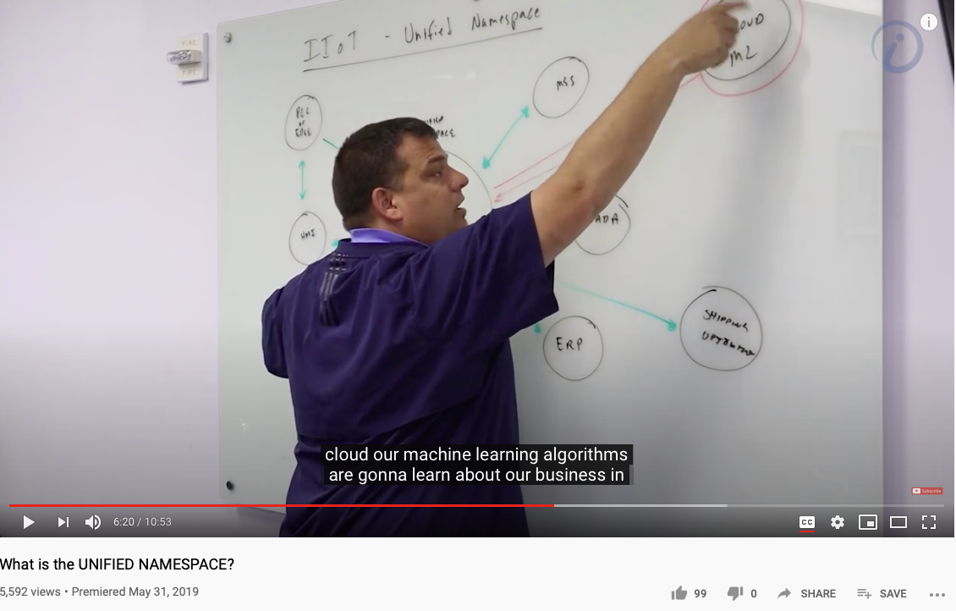
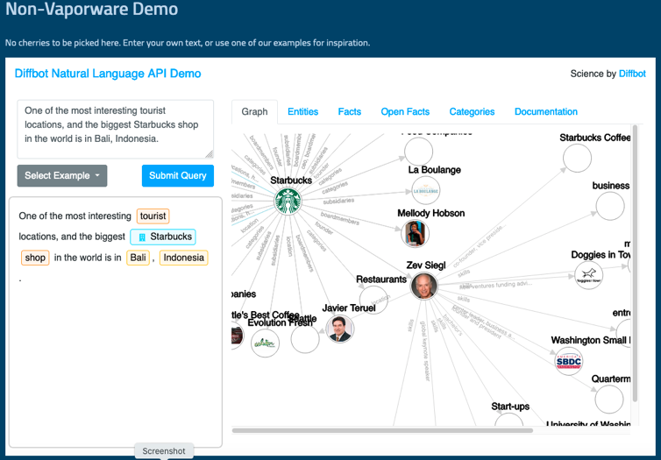
Unified Namespace

Slide 25
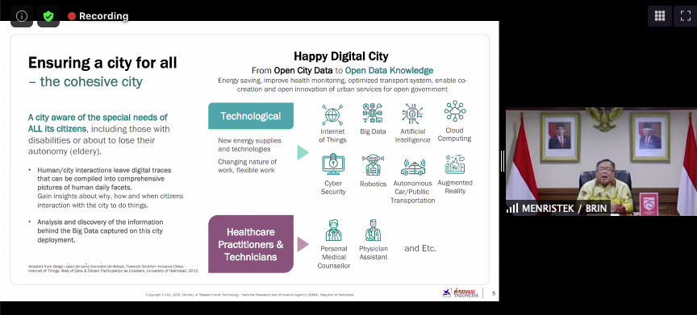
A Smart way to Govern Activities in Space-Time
Transform everything into Data
(Namespace Management)
Ongoing Development
RICH 70 Tsinghua SEA Cloud Forum, Sep 14, 2020
H. E. Bambang Brodjonegoro,
Minister of Research & Technology, Indonesia
Image credits: http://verses.io

Slide 26
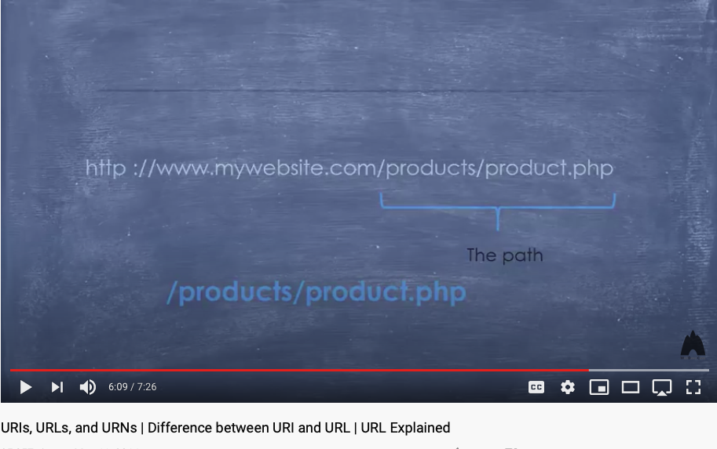
Universal Resource Locator, Identifier, Name as names of functions (especially with path information)
Video Link: https://youtu.be/vpYct2npKD8

Slide 27
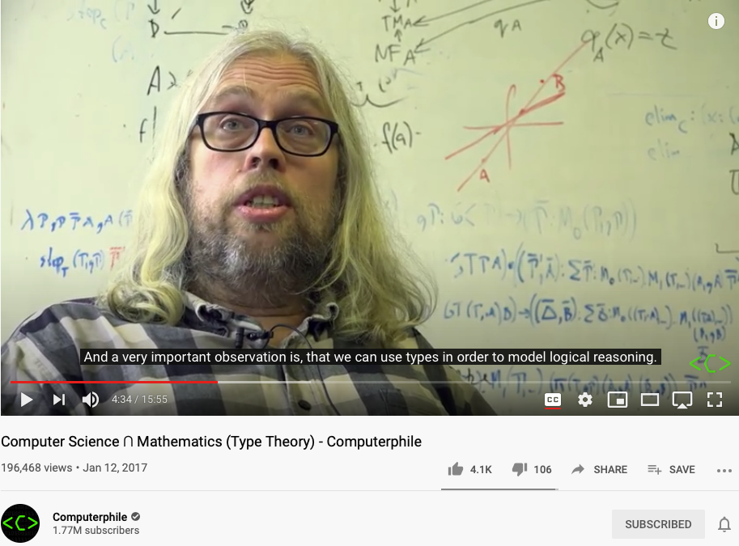
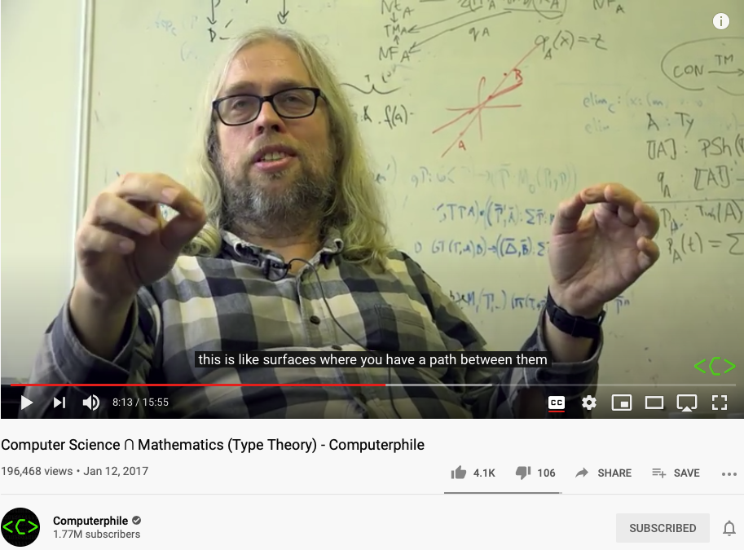
Modeling everything as Types of Functions
Because we cannot talk about implementation details, so that two things behaves the same on the outside must be the same.
This is the nature of
Namespace Management.
Video Link: https://youtu.be/qT8NyyRgLDQ?t=274
Video Link: https://youtu.be/qT8NyyRgLDQ?t=493

Slide 28
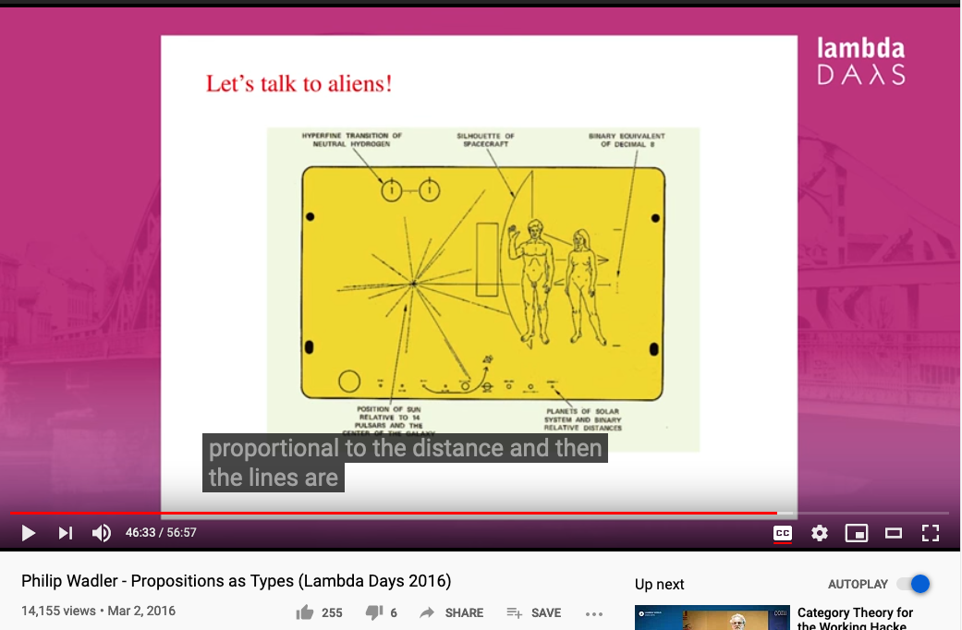
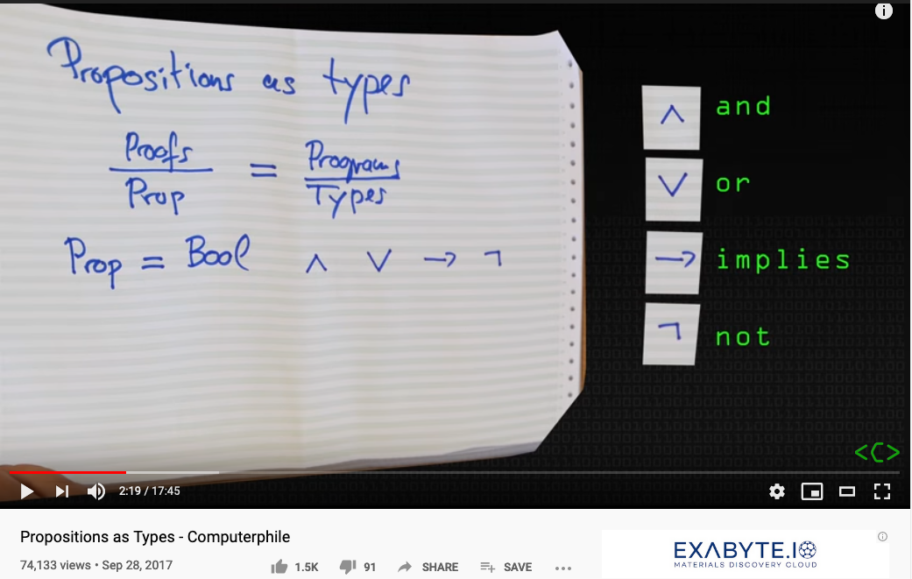
Propositions as Types (names with format)
Video Link: https://youtu.be/SknxggwRPzU?t=139
Video Link: https://youtu.be/aeRVdYN6fE8?t=2793

Slide 29
NsM complements Type Theory
(Logical) Propositions are types.
Types can be given concrete names.
Significant amount of logical reasoning can be automated.

Slide 30
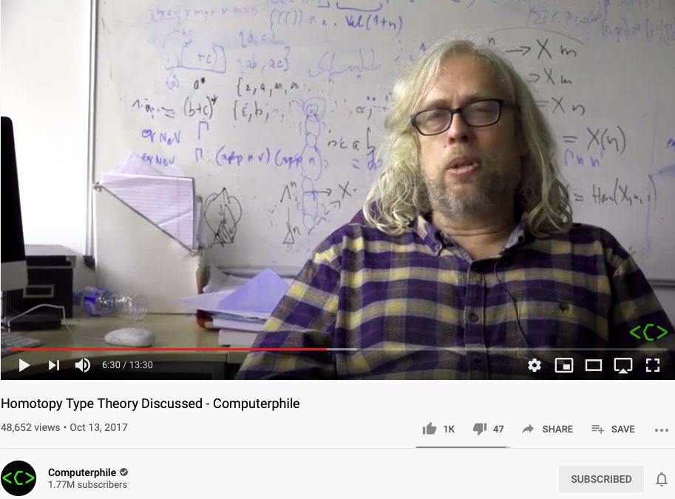
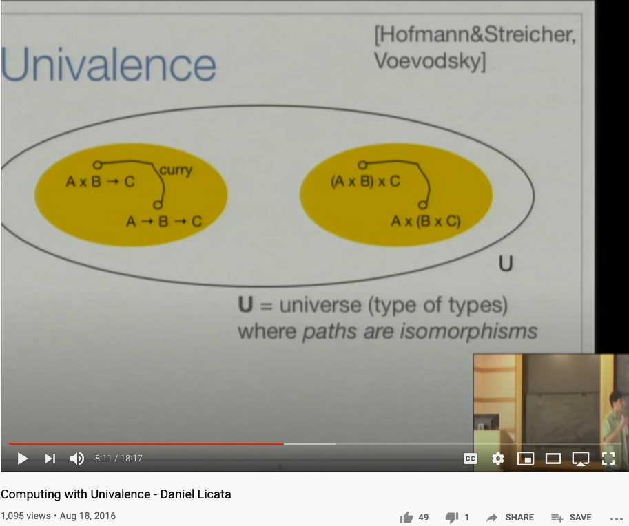
Representing Functions as Paths
Video Link: https://youtu.be/Ft8R3-kPDdk?t=390
Video Link: https://youtu.be/YDdDuq2AGw4

Slide 31
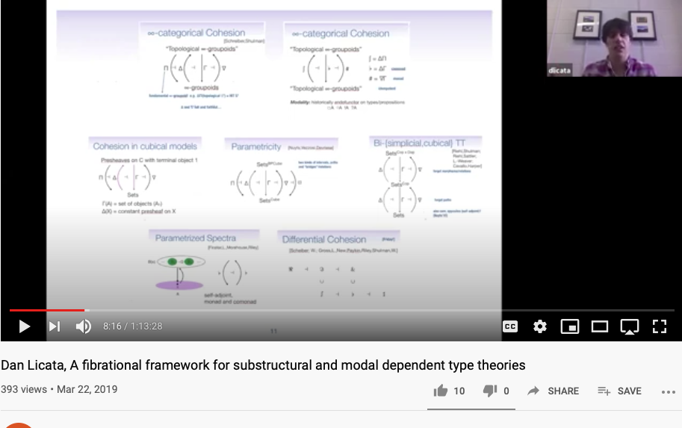
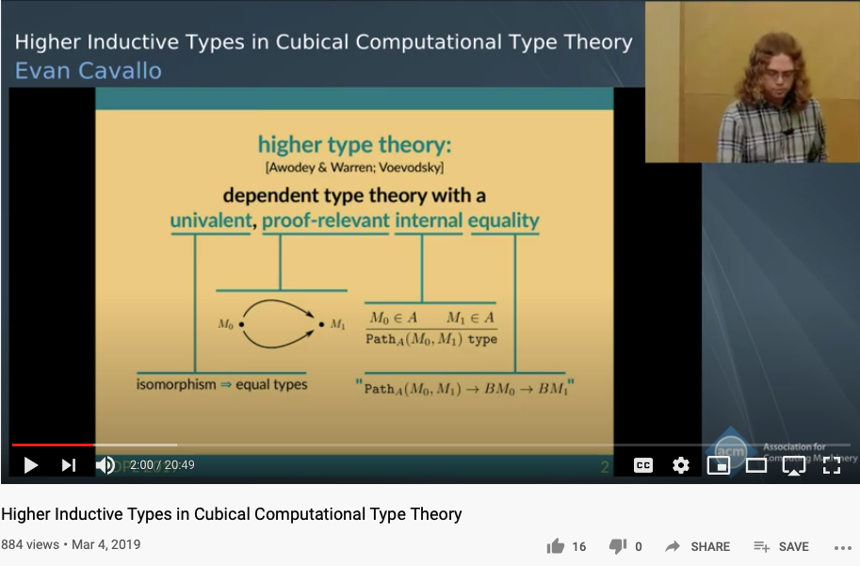
From Category Theory to Higher Type Theory
https://youtu.be/-DP0wY2FBs4?t=496
https://youtu.be/cmYzJAsjYSo

Slide 32
Soundness
Completeness
Every provable statement is true
Every true statement is provable
Cited from : Soundness and Completeness: With Precision on news.ycombinator.com

Slide 33

The Master Algorithm that will rule the world?
Bill Gates recommended this book
in 2016 Code Conference
The thesis:
Processing data through a single universal learning algorithm— can get all the knowledge from the past, the present, and the future
Pedro Domingos, TMA, P. 25
Chinese Translation
33

Slide 34
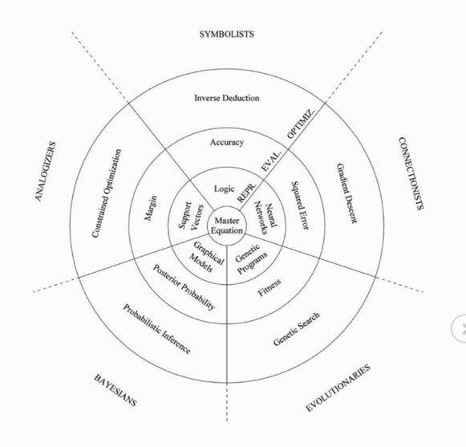
The Five Flavors of Master Algorithm
Image Source: Master Algorithm
Image Source: JavaPoint

Slide 35
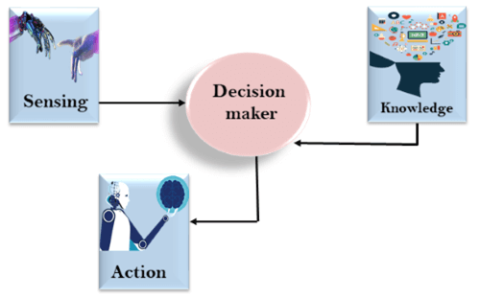
The Modern Workflow of Human Actions
Data Plane
Control Plane
Images from: JavaPoint

Slide 36
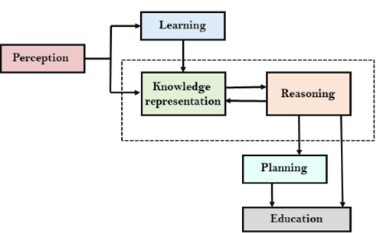
The Five Flavors of Master Algorithm
Images from: JavaPoint

Slide 37
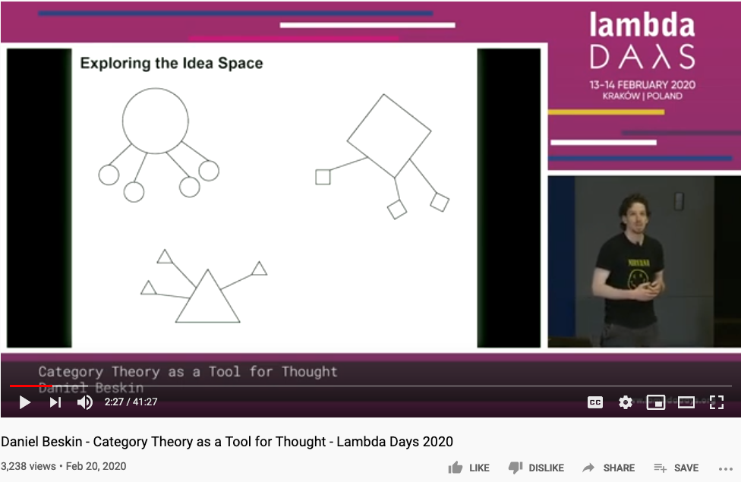
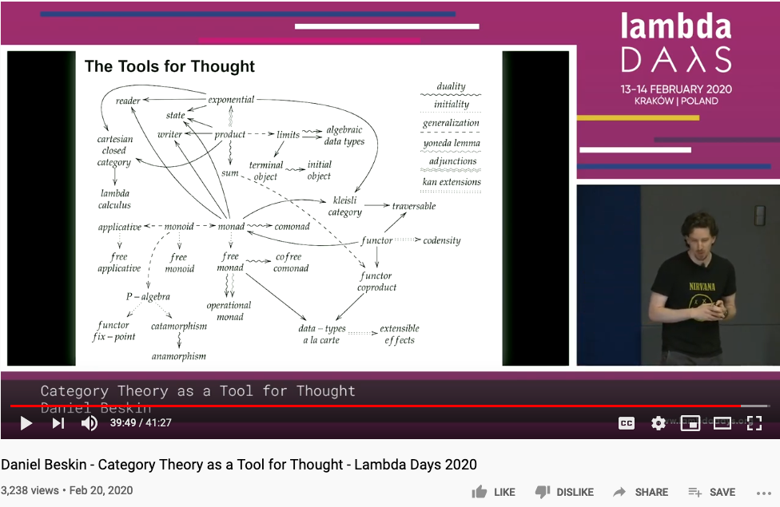
All concepts (ideas) are Kan Extensions -Saunder Mac Lane
https://github.com/ncreep/category-theory-as-a-tool-for-thought

Slide 38
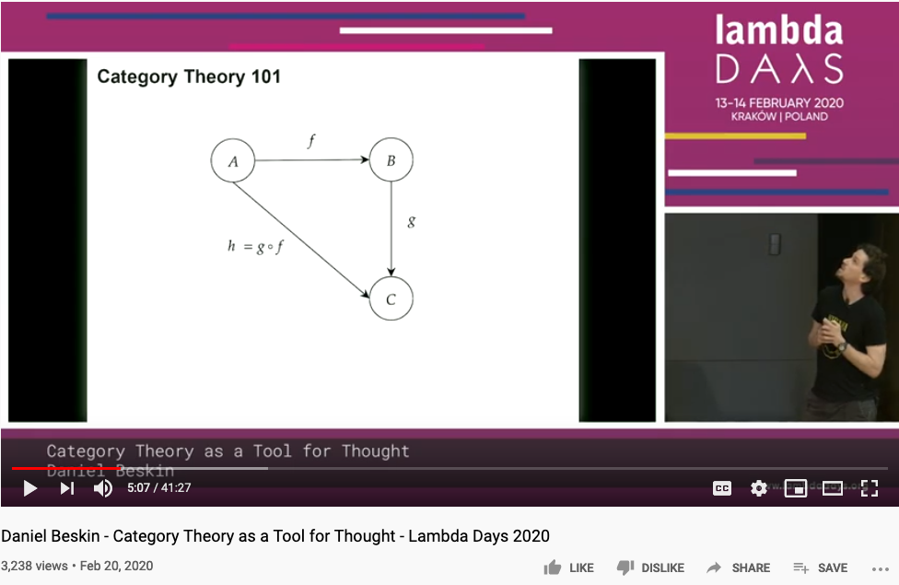
Category Theory is all about Composing Arrows

Slide 39
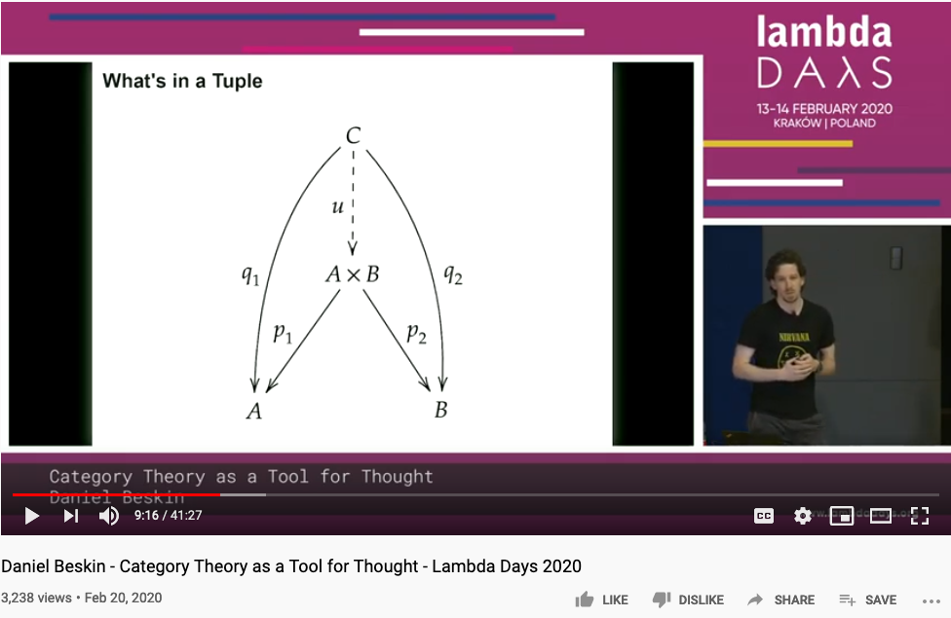

Universal Constructions

Slide 40

The Best One Hour Summary of Category Theory
Category Theory for Beginners (video series) -Richard Southwell

Slide 41


Higher Dimensional Structure denoted by Arrows
https://youtu.be/lmcT2mP2bfE?t=183
https://youtu.be/lmcT2mP2bfE?t=481

Slide 42


The Idea of Multiplication expressed in Arrows
https://youtu.be/lmcT2mP2bfE?t=967
https://youtu.be/lmcT2mP2bfE?t=1021

Slide 43
The World According to Category Theory
Find an image that shows arrow that
points to another arrow
A mathematical foundation based on one notation: arrow!
Also known as the arrow chasing computation.

Slide 44



The Types of Arrows
If it looks like a pig, walks like a pig, and taste like a pig, it is a pig.

Slide 45

Vertical Composition
Page. 175 of Category Theory for Programmers

Slide 46

Horizontal Composition
Page. 176 of Category Theory for Programmers

Slide 47



Kleisli Arrow of outrageous Fortune

Slide 48
Category Theory and Unary Arithmetic
How to do computation with only one symbol?
Verbs and Nouns are the same type!
Operators and Operands are “Terms” (Names)

Slide 49

Category Theory and Type Theory

Slide 50


Functor in Action
https://youtu.be/XcM39gnqgNc?t=155
https://youtu.be/YLIH8TKbAh4?t=389

Slide 51



Various ways to interpret Natural Transformation
Think about Natural Transformations as various kinds of Abstract Interpretations?

Slide 52

ALL Concepts can be represented using Kan Extension
A highly useful mathematical construct for teaching and learning abstractions.

Slide 53




Functional Composition/
De-composition
C
C ^{OP}
3D printing
3D printing
g
F ^{op}
f
f ⁻¹
g ⁻¹
2D printing
1D movement
(Opposite Functor)
2D printing
1D movement

Slide 54

Applied Category Theory
These mathematical ideas are strategies for Knowledge Representation

Slide 55
Conflicts/Branches/Intersections that don’t exist in Higher Dimensions

Slide 56


Counter Arguments in Higher Dimensions (intersection will not occur in Higher Dimensions)
https://youtu.be/lmcT2mP2bfE?t=551
https://youtu.be/lmcT2mP2bfE?t=579

Slide 57


Category Theory can generate concrete solutions
Represents ONLY SOME possible trajectories to the moon
NKS 2004, MIT A New Kind of Language for Complex Engineering Systems
Case Study: NASA’s Apollo Program Benjamin Koo
Edward F. Crawley

Slide 58


Category Theory is a way to formally represent “Analogies”
Let’s see the example :
Functor
Category
Natural Transformation
Source : Milewski, 2015

Slide 59



Kuhn’s Cycle and Category Theory
https://www.thwink.org/sustain/glossary/KuhnCycle.htm

Slide 60

Productivity loss due to Process Bottleneck
https://youtu.be/p7-U1_E_j3w

Slide 61

New Productivity came from CI/CD
https://youtu.be/p7-U1_E_j3w

Slide 62

关键词：Incommensurability （不可通约）
http://plato.stanford.edu/entries/incommensurability/
产业创新导致行为“范式”的转移
Paradigm shift (范式转移）
传统产业的范式，不再适用于新的社会环境
http://foodtank.com/news/2015/01/five-ways-cell-phones-are-changing-agriculture-in-africa

Slide 63


管理本体隐喻：管理MediaWiki词汇

Slide 64
Mathematical Models: A Sketch for the Philosophy of Math (1981)
Saunders Mac Lane从数学文献中所总结出的各种动词片语
Counting | Arithmetic, Number Theory
Measuring （度量） | Real Numbers, Calculus, Analysis
Shaping （分辨形体） | Geometry, Topology
Forming （成形） | Symmetry, Group Theory
Estimating （估测） | Probability, Measure Theory
Moving （移动） | Mechanics, Calculus, Dynamics
Calculating （计算） | Algebra, Numerical Analysis
Proving （证明） | Logic
Puzzling （解谜、加密） | Combinatorics, Number Theory
Grouping （聚类） | Set Theory, Combinatorics
http://links.jstor.org/sici?sici=0002-9890%28198108%2F09%2988%3A7%3C462%3AMMASFT%3E2.0.CO%3B2-D
Notes:
Category theory has become an important role in contemporary mathematics and theoretical computer science.

Slide 65
Carlo Rovelli的 Ontological Map of Space-Time
Covariant Loop Quantum Gravity: An Elementary Introduction of Quantum Gravity Theory and Spinfoam Theory
by Rovelli and Vidotto

Slide 66
Partially Ordered Set
The Hasse diagram of the set of all subsets of a three-element set {x, y, z}, ordered by inclusion. Distinct sets on the same horizontal level are incomparable with each other. Some other pairs, such as {x} and {y,z}, are also incomparable. (Image and Text Source: Wikipedia: POS )

Slide 67
Ontological Engineering (知识图谱)
Ontology engineering … studies the methods and
methodologies for building ontologies:
… formal representations of a set of concepts
… Core ideas and objectives of ontology engineering
are also central in conceptual modeling.
https://en.wikipedia.org/wiki/Ontology_engineering

Slide 68


Air Table/Google Table
https://youtu.be/r0lsyTaAuJE?t=16
https://youtu.be/EPs6BhLav94?t=32

Slide 69


可计算图形语意：Computable Semantics

Slide 70

Sensor Placement and Data Collection

Slide 71
The Best One Hour Summary of Category Theory
Category Theory for Beginners (video series)
-Richard Southwell

Slide 72

The Best Summary on Type Theory
By the Discoverer of Monad Prof. Philip Wadler

Slide 73

Dependent Type Theory

Slide 74
Summary
A comparison chart that extends Applied Category Theory’s table by David Spivak

Slide 75



References
Youtuber blargoner: An introduction to categories, functors, and universal properties, with applications to the lambda calculus and functional programming.

Slide 76



References

Slide 77
Your actions before Oct 19, 2020
Start using Templates and Categories on toyhouse.wiki:81
Create a page about your project, using standardized Templates and Category
Make sure all Wiki pages you created follow the same Namespace convention
Start using Github to download and share files with proper NsM
Couse Github @ https://github.com/benkoo/CognitiveFoundation2020
Start writing your learning report.
Every week should include Logic Model using the standard Template
500 words or more per week

Slide 78

References
An interesting website on Gödel Escher Bach
https://aseelghazal.weebly.com/
GEB book’s ToC
Preface to GEB's Twentieth-anniversary Edition P-1 Overview p. viii List of Illustrations p. xiv Words of Thanks p. xix Part I GEB Introduction: A Musico-Logical Offering p. 3 Three-Part Invention p. 29 Chapter I The MU-puzzle p. 33 Two-Part Invention p. 43 Chapter II Meaning and Form in Mathematics p. 46 Sonata for Unaccompanied Achilles p. 61 Chapter III Figure and Ground p. 64 Contracrostipunctus p. 75 Chapter IV Consistency, Completeness, and Geometry p. 82 Little Harmonic Labyrinth p. 103 Chapter V Recursive Structures and Processes (...read more)

